Slide 1

BECE204L – MICROPROCESSOR & MICROCONTROLLERS

Slide 2
Module – 2:
MICROPROCESSOR ARCHITECTURE & INTERFACING : INTEL x86

Slide 3
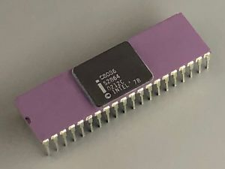
Introduction to 8086
Backward compatible with 8085
Memory interfacing technique is similar, though memory addressing is different
40-pin DIP, 5V supply
29,000 transistors
20 bit address to access memory
(memory space = 2²⁰ = 1MB)

Slide 4
8086 Registers
“General Purpose” & “Special Purpose”
16 bit registers
GP Registers:
Can be used as 8 bit or 16 bit
Used for holding data, variables, and intermediate results temporarily
SP Registers:
Used as segment registers, pointers, index registers or as offset storage registers for some addressing modes

Slide 5
Register Groups
General data registers
Segment registers
Pointers & index registers
Flag registers

Slide 6
General Data Registers
X, H, L ?
AX - Accumulator
CX – Default counter in string and loop operations
BX – Offset storage for forming physical address
DX – Implicit operand/ destination in few instructions

Slide 7
Segment Registers
8086 addresses segmented memory
Total 1MB is divided into 16 logical segments; each segment having 64KB memory
4 segment registers
CS – used for addressing a memory location in the code segment of the memory
DS – points to the data segment of the memory
ES – Another data segment used along with DS
SS – used to address stack segment, memory to store stack data, main operations are Push & Pop

Slide 8
Segment Registers
While addressing any location in the memory bank, address is calculated from two parts:
Segment address
Offset
SR contains the 16-bit segment base address, related to different segments
Any of the pointers/index registers/ BX may contain the offset of the location to be addressed
This scheme is advantageous, as address bits are 20 and machine operates at 16 bits.

Slide 9
Pointers & Index Registers
Pointers contain offsets within the particular segments
Instruction Pointer (IP): The instruction pointer usually stores the address of the next instruction that is to be executed.
Base Pointer (BP): The Base pointer stores the base address of the memory. Also, it acts as an offset for Stack Segment (SS).
Stack Pointer (SP): The Stack Pointer Points at the current top value of the Stack. Like the BP, it also acts as an offset to the Stack Segment (SS).
Source Index (SI): It stores the offset address of the source.
Destination Index (DI): It stores the offset address of the Destination.

Slide 10
Flag Registers
The Flag or Status register is a 16-bit register which contains 9 flags, and the remaining 7 bits are idle in this register.
These flags tell about the status of the processor after any arithmetic or logical operation. IF the flag value is 1, the flag is set, and if it is 0, it is said to be reset.
Indicates the results of computations in the ALU.
Also contains some flag bits to control CPU operations.

Slide 11
8086 Architecture
Supports 16-bit ALU, set of 16-bit registers
8086 is a 16-bit Integer processor in a 40 pin, Dual Inline Packaged IC
8086 provides the programmer with 14 internal registers, each 16 bits or 2 Bytes wide.
To increase execution speed and fetching speed, 8086 segments the memory.
It’s 20 bit address bus can address 1MB of memory, it segments it into 16 64kB segments.
8086 works only with four 64KB segments within the whole 1MB memory.
Powerful interrupt structure
Fetched instruction queue

Slide 12
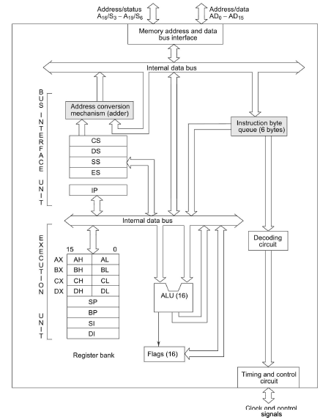
8086 Architecture
BIU
Contains circuit for phy add calculation and a precoding instruction byte queue. It makes the system’s bus signals available for external interfacing of devices
Execution Unit (EU)
EU contains the register set except SRs and IP. It has a 16-bit ALU. EU tells BIU where to fetch the instructions/data from, decodes instructions and executes instructions that have already been fetched by the BIU.
BIU and EU functions separately.

Slide 13
Execution Unit

Slide 14
Execution Unit
Contains control circuitry which directs internal operations.
The main components of the EU are General purpose registers, the ALU, Special purpose registers, Instruction Register and Instruction Decoder and the Flag/Status Register.
Fetches instructions from the Queue in BIU, decodes and executes arithmetic and logic operations using the ALU.
Sends control signals for internal data transfer operations within the microprocessor.
Sends request signals to the BIU to access the external module.

Slide 15
Special Purpose Register
Stack Pointer: Points to Stack top. Stack is in Stack Segment, used during instructions like PUSH, POP, CALL, RET etc.
Base Pointer: BP can hold offset address of any location in the stack segment. It is used to access random locations of the stack.
Source Index: It holds offset address in Data Segment during string operations.
Destination Index: It holds offset address in Extra Segment during string operations.

Slide 16
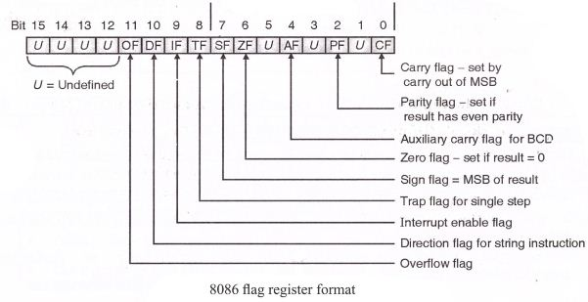
Flag Register
A flag is a FF that indicates some condition produced by the execution of an instruction or controls certain operations of the EU.
16-bit flag register contains 9 active flags, out of which 6 are used to indicate some condition produced by an instruction
Condition Flags
Control Flags

Slide 17
Execution Unit (EU)
Auxiliary Carry Flag
This is set, if there is a carry from the lowest nibble, i.e, bit three during addition, or borrow for the lowest nibble, i.e, bit three, during subtraction.
Carry Flag
This flag is set, when there is a carry out of MSB in case of addition or a borrow in case of subtraction.
Sign Flag
This flag is set, when the result of any computation is negative
Zero Flag
This flag is set, if the result of the computation or comparison performed by an instruction is zero
Parity Flag
This flag is set to 1, if the lower byte of the result contains even number of 1’s ; for odd number of 1’s set to zero.
15 | 14 | 13 | 12 | 11 | 10 | 9 | 8 | 7 | 6 | 5 | 4 | 3 | 2 | 1 | 0
 |  |  |  | OF | DF | IF | TF | SF | ZF |  | AF |  | PF |  | CF
Over flow Flag
This flag is set, if an overflow occurs, i.e, if the result of a signed operation is large enough to accommodate in a destination register. The result is of more than 7-bits in size in case of 8-bit signed operation and more than 15-bits in size in case of 16-bit sign operations, then the overflow will be set.
Trap Flag
If this flag is set, the processor enters the single step execution mode by generating internal interrupts after the execution of each instruction
Direction Flag
This is used by string manipulation instructions. If this flag bit is ‘0’, the string is processed beginning from the lowest address to the highest address, i.e., auto incrementing mode. Otherwise, the string is processed from the highest address towards the lowest address, i.e., auto incrementing mode.
Interrupt Flag
Causes the 8086 to recognize external mask interrupts; clearing IF disables these interrupts.

Slide 18

GP Register
Temporary storage of data, allows quick access
Base Register (BX)
This is the only general purpose register whose contents can be used for addressing the 8086 memory.
Counter Register (CX)
Instructions such as SHIFT, ROTATE and LOOP use
the contents of CX as a counter.
Data Register (DX)
Used to hold the high 16-bit result (data) in
16 X 16 multiplication or the high
16-bit dividend (data) before a 32 $÷$ 16
division and the 16-bit reminder after division.

Slide 19
Bus Interface Unit

Slide 20
Bus Interface Unit
It provides the interface of 8086 to external memory and I/O devices via the System Bus. It performs various machine cycles such as memory read, I/O read etc. to transfer data between memory and I/O devices.
BIU performs the following functions
It generates the 20 bit physical address for memory access.
It fetches instructions from the memory.
It transfers data to and from the memory and I/O.
Maintains the 6 byte prefetch instruction queue(supports pipelining).
BIU mainly contains the 4 Segment registers, the Instruction Pointer, a prefetch queue and an Address Generation Circuit.

Slide 21
Segment Register
Out of the available 1MB memory, at any given time, 8086 works only with four 64KB segments (total 16 segments).
SR holds the first 16 bits of the starting address of the four memory segments.
Address Generation Circuit:
The BIU has a Physical Address Generation Circuit.
It generates the 20 bit physical address using Segment and Offset addresses using the formula:
Physical Address = Segment Address x 10H + Offset Address

Slide 22
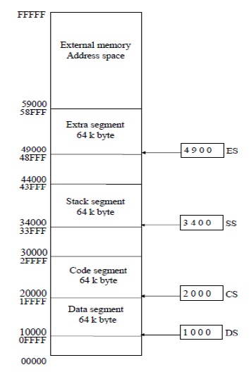

Slide 23
Instruction Pointer
It is a 16 bit register. It holds offset of the next instructions in the Code Segment.
IP is incremented after every instruction byte is fetched.
IP gets a new value whenever a branch instruction occurs.
CS is multiplied by 10H to give the 20 bit physical address of the Code Segment.
Address of the next instruction is calculated as CS x 10H + IP.

Slide 24
SS & SP
Stack is a section of memory set aside to store addresses and data while a subprogram is executing.
8086 allows an entire 64KB segment as a stack.
SS holds the upper 16-bit of the starting address of this segment.
SP in the EU holds the 16-bit offset from the start of the segment to the memory location where a word was recently stored on the stack.
Memory location where a word was most recently stored is called the top of stack.

Slide 25
Basics of Addressing Mode
An instruction is a basic command given to a microprocessor to perform a specified operation with given data.
Each instruction has two groups of bits.
One group of bits is known as operation code (Opcode), which defines what operation will be performed by the instruction.
The other field is called operand, which specifies data that will be used in arithmetic and logical operations.
The operand can specify a register or a memory location in any one of the memory segments or I/O ports.
The addressing mode is used to locate the operand or data.
There are different types of addressing modes depending upon the location of data in the 8086 processor.

Slide 26
Basics of Addressing Mode
Most 8086 instructions can operate on the 8086’s general purpose register set.
By specifying the name of the register as an operand to the instruction, you may access the contents of that register.
Consider the 8086 mov (move) instruction:
mov destination, source
This instruction copies the data from the source operand to the destination operand.
The eight and 16 bit registers are certainly valid operands for this instruction.
The only restriction is that both operands must be the same size.

Slide 27
Basics of Addressing Mode
mov ax, bx ;Copies the value from BX into AX
mov dl, al ;Copies the value from AL into DL
mov si, dx ;Copies the value from DX into SI
mov sp, bp ;Copies the value from BP into SP
mov dh, cl ;Copies the value from CL into DH

Slide 28
Basics of Addressing Mode
In addition to the general purpose registers, many 8086 instructions (including the mov instruction) allow you to specify one of the segment registers as an operand.
There are two restrictions on the use of the segment registers with the mov instruction.
First of all, you may not specify cs as the destination operand,
second, only one of the operands can be a segment register.
You cannot move data from one segment register to another with a single mov instruction.
To copy the value of cs to ds, you’d have to use some sequence like:
mov ax, cs
mov ds, ax
You should never use the segment registers as data registers to hold arbitrary values.
They should only contain segment addresses

Slide 29
Types of Addressing Mode
Sequential Control Flow Instructions
Instructions that transfer control to the next instruction appearing immediately after it in the program.
Eg. Arithmetic, logical, data transfer and processor control instructions.
Control Transfer Instructions
Transfer the control to some predefined address in the instruction
Eg.: INT, CALL, RET, JUMP

Slide 30
Immediate Addressing
Immediate addressing transfers the source, an immediate byte or word data, into the destination register.
Immediate data means constant data, whereas data transferred from a register or memory location are variable data.
Immediate date may be 8-bit or 16 bit.
Example: MOV BL, 44 ; Copies 44 decimal (2CH) into BL
MOV AX, 44H ; Copies 0044H into AX
MOV AL, ‘A’ ; Copies ASCII of the letter A into AL

Slide 31
Direct or Displacement Addressing
A 16-bit memory address (offset) or an IO address is specified directly in the instruction.
Eg. MOV AX, [5000H]; Data resides in a memory location in the data segment, whose effective address is computed using 5000H as offset and the content of DS as segment address
IN 80H; 80H is an IO address

Slide 32
Register Addressing
In the Register addressing mode, the data is stored in a register and it is referred using a particular register.
All registers except IP may be used in this mode.
8-bit register names with register addressing: AH, AL, BH, BL, CH, CL, DH, DL.
16-bit register names: AX, BX, CX, DX, SP, BP, SI ,DI, CS, SS, DS and ES.
Never mix an 8-bit register with 16-bit, it is not allowed in microprocessor.
Code segment register (CS) is never used as destination.
Segment to segment MOV instruction is not allowed.
Example: MOV AL, BL ; Copies 8-bit content of BL into AL
MOV AX, CX ; Copies 16-bit content of CX into AX
MOV ES, DS ; Not allowed (segment to segment)
MOV BL, DX ; Not allowed (mixed size)
MOV CS, AX ; Not allowed (Code segment register may not be destination register)

Slide 33
Register Indirect Addressing
The address of the memory location which contains data is determined in an indirect way, using the offset registers.
The offset address of data is stored in BX, DI and SI.
The data segment or extra segment is used by default
The [ ] symbol denote indirect addressing in assembly language.
Example:
MOV CX, [BX] ; Copies the word contents of the data segment memory location addressed by BX into CX.
MOV [DI], [BX] ; Memory to memory transfers are not allowed except with string inst.

Slide 34
Base Addressing Mode
In this addressing mode, the offset address of the operand is given by the sum of contents of the BX/BP registers and 8-bit/16-bit displacement.
Example:
MOV DX, [BX+04]
ADD CL, [BX+08]
MOV AX, 50H[BX] ; Effective address is given as DS*10H + 50H + [BX] .
MOV 10H[SI], DX ; Content of DX is transferred to address DS*10H + 10H + [SI]

Slide 35
Indexed Addressing Mode
Offset of the operand is stored in one of the index registers.
DS is the default segment register for DI and SI.
In case of string instruction, DS and ES are default segment registers for SI & DI respectively.
This is a special case of register indirect addressing mode.
Example: MOV AX, [SI] ; Data is available in data segment, at an offset address stored in SI .
MOV CX, [DI] ; Content of address DS*10H + [DI] will be
transferred to CX

Slide 36
Base Indexed Addressing Mode
In this addressing mode, data is available at an effective address formed by adding the content of any one of the base registers (BP or BX) to the content of an index register (SI or DI).
The default segment may be DS or ES.
Example:
MOV AX, [BX] [SI] ; Effective address is given as DS*10H + [BX] + [SI].
MOV [BX] [DI], AX ; Content of AX is transferred to address DS*10H + [BX] + [DI]

Slide 37
Base Indexed displacement Addressing
The effective address is formed by adding an 8-bit or 16-bit displacement with the sum of contents of any one of the base registers (BP or BX) and any one of the index registers (SI or DI).
The default segment may be DS or ES.
Example:
MOV AX, 50H [BX] [SI] ; Effective address is given as DS*10H + 50H + [BX] + [SI].
ADD 50H [BX] [SI], BP ; Content of BP is added with that in the memory location whose offset is given by DS*10H + 50H + [BX] + [SI], result is stored in this memory location.

Slide 38
Physical Address Calculation
The content of the segment register is shifted left bit-wise four times (Multiply the 16-bit hex value by 10H).
To this result, the content of an offset register is added, to produce 20-bit physical address.
Offset registers for the different segments are indicated below:
BX/ SI/ DI – Data Segment/ Extra Segment
IP – Code Segment
BP – Starting address of Stack
SP – Top of stack

Slide 39
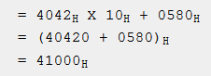
Example
The value of Code Segment (CS) Register is 4042H and the value of different offsets is as follows: BX: 2025H , IP: 0580H , DI: 4247H. Calculate the effective address of the memory location pointed by the CS register.
The offset of the CS Register is the IP register.
Shift base address 4-bits and Add offset address
= (469A0)_{H}

Slide 40
Practice Problem
The value of the DS register is 3032H. And the BX register contains 3040H. Find the physical address.
33360H

Slide 41
Practice Problem
You are provided with the following values: DS: 3056H, IP: 1023H, BP: 2322H and SP: 3029H. Can you calculate the effective address of the memory location as per the DS register?

Slide 42
Example
Direct Addressing: MOV AX, [5000H]
Register Indirect: MOV AX, [BX]
Register Relative: MOV AX, 5000H [BX]
Based Indexed: MOV AX, [BX] [SI]
Relative Based Indexed: MOV AX, 5000H [BX] [SI]

Slide 43
Answer

Slide 44
Answer

Slide 45
Answer

Slide 46
Answer

Slide 47
Types of Instructions
Data Transfer Instructions
Arithmetic Instructions
Logical Instructions
String manipulation Instructions
Process Control Instructions
Control Transfer Instructions

Slide 48
Data Transfer/Copy Instructions
Transfer data from source operand to destination operand
Instruction to transfer a word
MOV − Transfer data from one register/memory locations to another register/memory location
MOV DS, 5000H //Invalid - segment register cannot be destination register in immediate addressing mode
MOV AX, 5000h Immediate
MOV DS, AX Register
MOV AX, BX
MOV AX, [SI] Indirect
MOV AX, [2000H] Direct
MOV AX, 50H[BX] Base

Slide 49
Data Transfer/Copy Instructions
PUSH
This instruction pushes the contents of specified register/ memory location on to the stack.
SP is decremented by 2 after each execution of the instruction.
The actual current stack top is always occupied by the previously pushed data.
Hence, the push operation decrements SP by two and then stores the two byte contents of the operand onto the stack.
The higher byte is pushed first and then the lower byte.
Thus, the higher byte occupies the higher address.

Slide 50
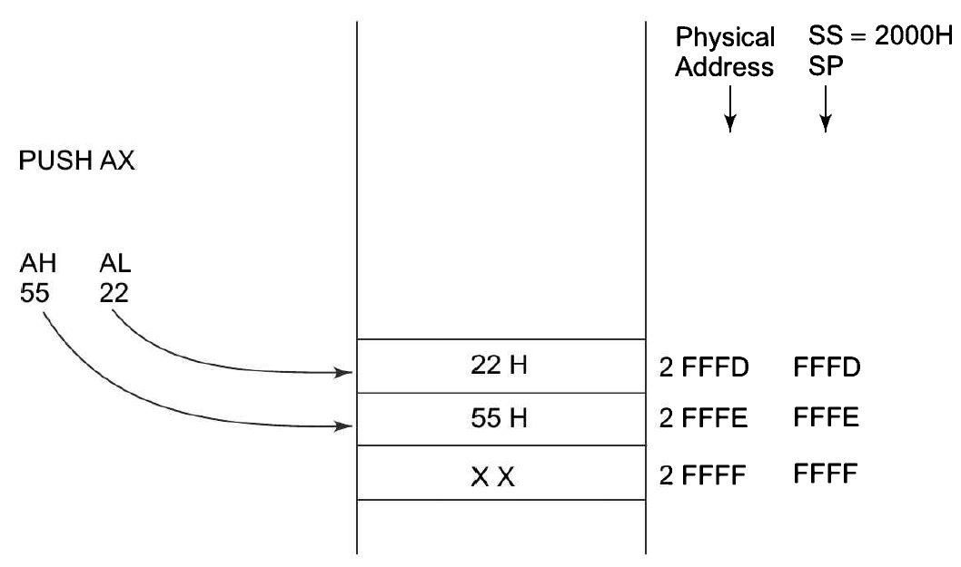
PUSH
PUSH: Push to Stack
Pushes the content of specified register/memory location on to the stack
PUSH AX
PUSH DS
PUSH [5000H]
SP decremented by 2
PPUSH − Put a word at the top of the stack
PUSHA − Used to put all the registers into the stack
Pushing data to Stack Memory

Slide 51
Data Transfer/Copy Instructions
POP
This instruction loads the specified register/ memory location with the contents of the memory location of which the address is formed by the SS & SP.
SP is incremented by 2, with each execution of the instruction.
Sequence of operation:
Contents of stack top memory location is stored in AL & SP is incremented by 1.
The contents of the memory location pointed now by SP is copied to AH & SP is again incremented by 1.

Slide 52
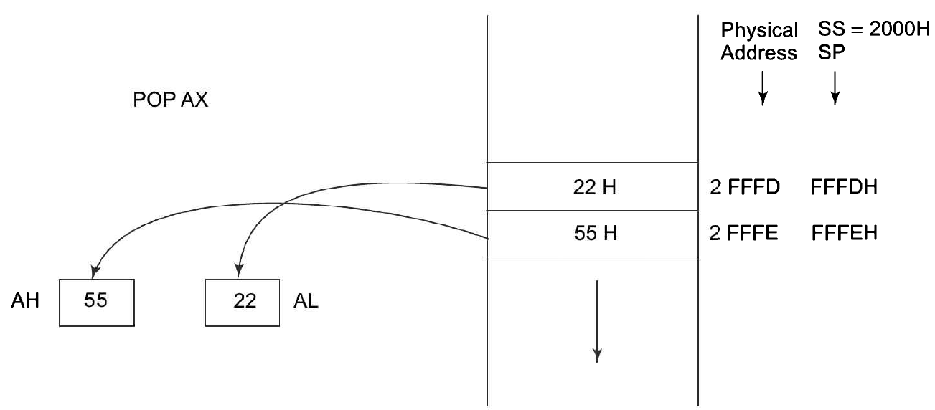
POP
Used to get a word from top of the stack
POP AX
POP DS
POP [5000H]
SP incremented by 2
POPA − Used to get words from the stack to all registers
Popping register contents from Stack Memory

Slide 53
Data Transfer/Copy Instructions Cont’d
XCHG
Exchange the content of specified source and destination operands
Register - memory
Memory – Memory (Not allowed)
Immediate data (Not allowed)
XCHG [5000H], AX // AX and memory location 5000H in DS
XCHG BX, AX
XLAT
- This instruction is used for finding out the codes in case of code conversion problems, using lookup table technique.

Slide 54
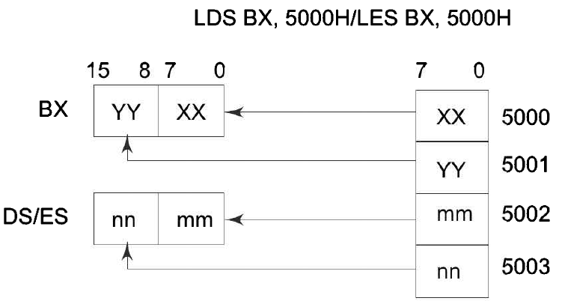
Instructions to Transfer the Address
Load Effective Address (LEA)
Loads the effective address formed by destination operands
LEA BX, ADR //EA of Label ADR transferred to BX
LEA SI, ADR[BX] // Offset of ADR added with content of BX and loaded in SI
LDS/LES: Loads DS/ES register and the specified destination register with the content of memory location given as source
LDS BX, 5000H
LES BX, 5000H

Slide 55
Instructions to transfer flag registers
LAHF: Load AH from lower Byte of Flag
Used to observe the status of all the condition code flags (except overflow) at a time
SAHF: Store AH from lower Byte of Flag
PUSHF: Push flags to stack
POPF: Loads the flag register completely form the word contents of the memory location currently addressed by SP and SS

Slide 56
Instructions for Input and Output Port Transfer
IN: Input the port
Used for reading an input port
Address of the input port may be specified in the instruction directly or indirectly
AL and AX allowed destination for 8-bit and 16-bit input operations
DX – only register allowed to carry the port address
IN AL, 03H // Reads data from an 8-bit port with address 03H and stores it in AL
IN AX, DX // Reads data from a 16-bit port whose address is in DX and stores it in AX
MOV DX, 0800H // 16-bit address taken in DX
IN AX, DX

Slide 57
Instructions for Input and Output Port Transfer
OUT: Output to the port
Write content of AL or AX to an output port
Address of the output port may be specified in the instruction directly or implicitly in DX
OUT 03H, AL // Send data available in AL to port whose address is 03H
MOV DX, 0300H
OUT DX, AX

Slide 58
Arithmetic Instructions

Slide 59
Arithmetic Instructions
Addition
Subtraction
Multiplication
Division
ASCII
Decimal adjust instructions
Increment
Decrement
Affect all the condition code flags
Operand – Register, Memory location or immediate data

Slide 60
ADD
Memory to memory addition not possible
Contents of segment registers cannot be added
ADD AX, 0100H // Immediate
ADD 0100H // Immediate
ADD AX, BX // Register
ADD AX, [SI] // Register Indirect
ADD AX, [5000H] // Direct
ADD [5000H], 0100H // Immediate

Slide 61
ADC
Add with carry
Same as ADD but adds carry flag bit
ADC AX, 0100H // Immediate
ADC 0100H // Immediate
ADC AX, BX // Register
ADC AX, [SI] // Register Indirect
ADC AX, [5000H] // Direct
ADC [5000H], 0100H // Immediate

Slide 62
INC, DEC
INC
Increase the content of specified register or memory location by 1
INC AX
INC [BX]
INC [5000H]
Affect all condition code flags except carry flag (CF)
DEC
Subtract 1 from the contents of specified register or memory location
DEC AX
DEC [BX]
DEC[5000H]

Slide 63
SUB, SBB
Subtract source from destination operand
Result left in destination operand
Source operand – Register, memory location or immediate data
Destination operand – Register/memory location
Source and destination both must not be memory operands
Destination cannot be an immediate data
SUB AX, 0100H
SUB AX, BX
SUB AX, [5000H]
SUB [5000H], 0100H

Slide 64
SBB
Subtract the source operand and borrow flag from the destination operand
SBB AX, 0100H
SBB AX, BX
SBB AX, [5000H]
SBB [5000H], 0100H

Slide 65
CMP
Compares the source operand with destination operand
Source operand
Register/immediate data/memory location
Destination operand
Register/memory location
Does not store the result anywhere
Zero flag set – If both the operands are equal
Carry flag is set – If the source operand > destination operand
Carry flag is reset - If the source operand < destination operand
CMP

Slide 66
DAA
Decimal Adjust Accumulator
Convert the result of the addition of two packed BCD numbers to a valid BCD number
The result has to be only in AL
AL = 53 CL = 29
ADD AL, CL ;
AL ←(AL) + (CL) ;
AL ← 53 + 29 ;
AL ← 7C
DAA ;
AL ← 7C + 06 (as C>9) ;
AL ← 82

Slide 67
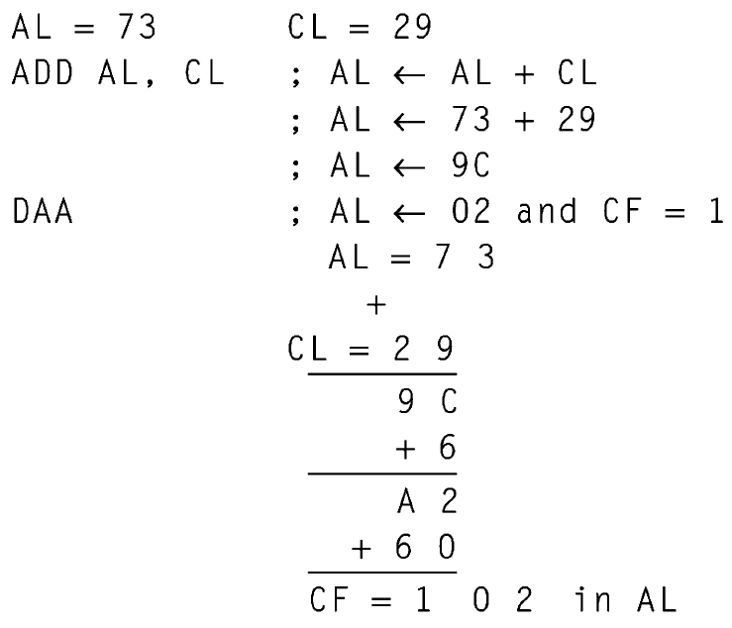
DAA

Slide 68
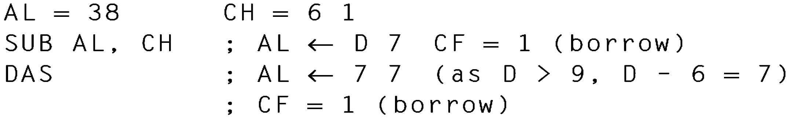
DAS
Decimal Adjust after Subtraction
Converts the result of the subtraction of two packed BCD numbers to a valid BCD number
The subtraction has to be in AL only
AL = 75, BH = 46
SUB AL, BH ;
AL ← (AL) - (BH) ;
AL ← 2 F ;
DAS ;
AL 2 9 (as F>9, F - 6 = 9); CF = 1

Slide 69
Logical Instructions
AND : Logical AND
Bit by bit ANDs source operand to the destination operand
Source operand – immediate, register or a memory location
Destination operand a register or a memory location
The result is stored in the destination operand
AND AX, 0008H
AND AX, BX
AND AX, [5000H]
AND [5000H], AX

Slide 70
Logical Instructions
OR : Logical OR
Bit by bit ORs the source operand to the destination operand
Result is stored in the destination operand
OR AX, 0008H
OR AX, BX
OR AX, [5000H]
OR [5000H], AX
NOT : Logical Invert
Complements the contents of an operand register or a memory location, bit by bit
NOT AX
NOT [5000H]

Slide 71
Logical Instructions
XOR : Logical Exclusive OR
Bit by bit XORs the source operand to the destination operand
The result is stored in the destination operand.
XOR AX, 0098H; XOR AX, BX; XOR AX, [5000H]
TEST : Logical Compare Instruction
Bit by bit logical AND operation on the two operands
Each bit of the result is set to 1 if corresponding bits of both the operands are 1 else result bit is reset to 0
The result of this ANDing operation is not available for further use, but flags are affected
TEST AX, BX; TEST [0500], 06H ; TEST [BX] [SI], CX

Slide 72
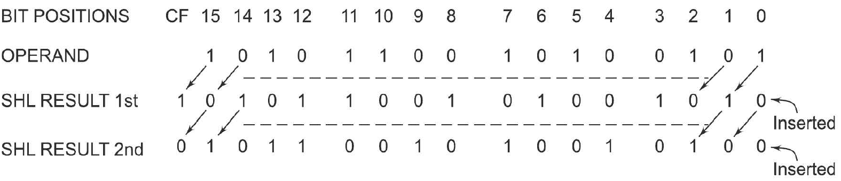
Logical and Arithmetic Left Shift
SAL/SHL : Shift Logical/Arithmetic Left
Shifts each bit in the specified destination to the left and 0 is stored at LSB position
The MSB is shifted into the carry flag
The number of shifts is indicated by count
SAL / SHL destination, count
SAL CX, 1
SAL AX, CL

Slide 73
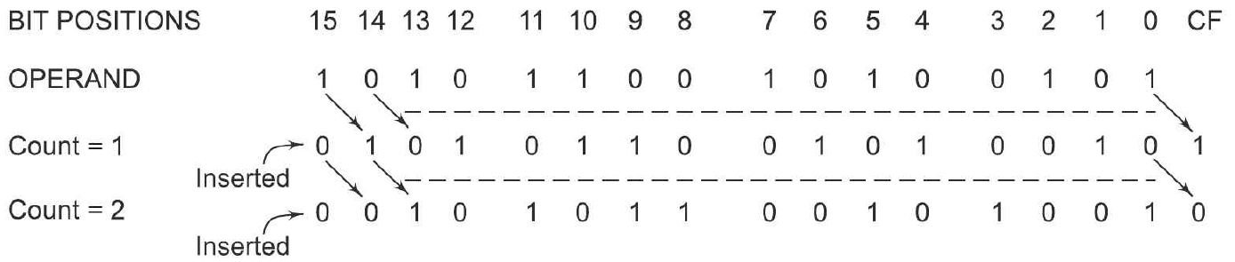
Logical Right Shift
SHR : Shifty Logical Right
Shifts each bit in the specified destination to the right and 0 is stored at MSB position
The LSB is shifted into the carry flag
The number of shifts is indicated by count
SHR destination, count
SHR CX, 1; MOV CL, 05H; SHR AX, CL

Slide 74
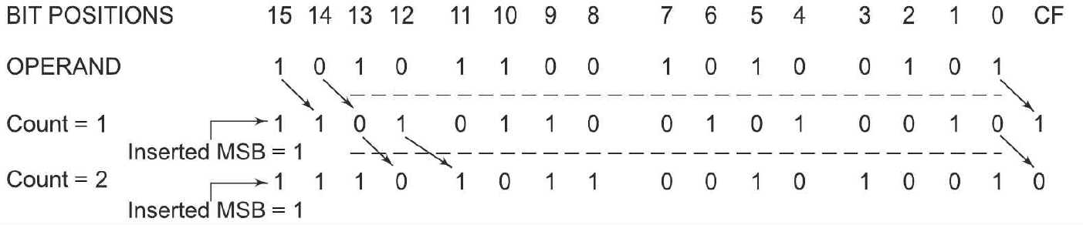
Arithmetic Right Shift
SAR : Shift Arithmetic Right
Shifts each bit in the specified destination some number of bit positions to the right
As a bit is shifted out of the MSB position, a copy of the old MSB is put in the MSB position
The LSB will be shifted into CF
SAR destination, count
SAR BL, 1 ; MOV CL, 05H; SAR DX, CL

Slide 75
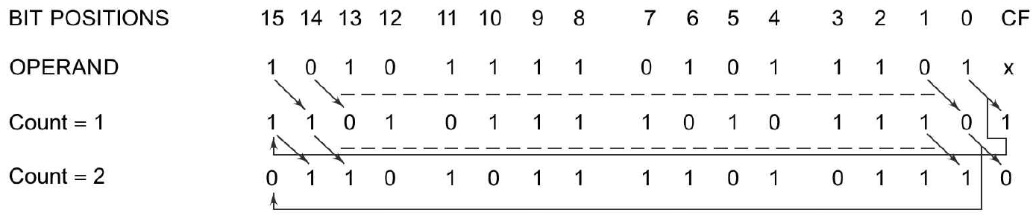
Rotate Instructions
ROR Instruction : ROR destination, count
Rotates all bits in a specified byte or word to the right some number of bit positions
LSB is placed as a new MSB and a new CF.
ROR CX, 1; MOV CL, 05H; ROR BL, CL

Slide 76
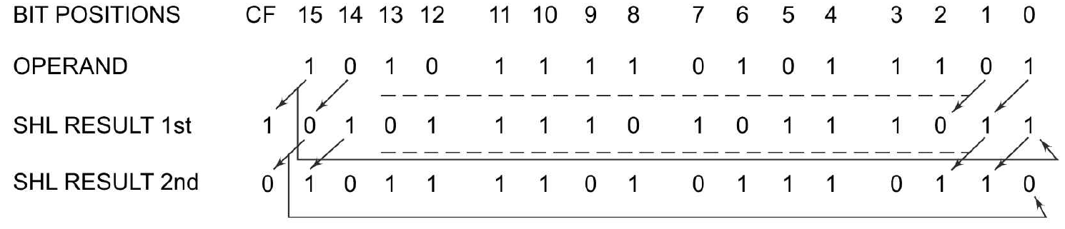
ROL
ROL Instruction : Rotate Left without Carry
Rotates all bits in a specified byte or word to the left some number of bit positions
MSB is placed as a new LSB and a new CF
ROL destination, count
ROL CX, 1 MOV CL, 05H; ROL BL, CL

Slide 77
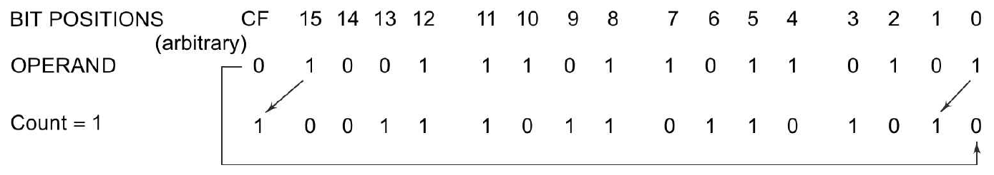
RCL
RCL Instruction :
Rotates all bits in a specified byte or word some number of bit positions to the left along with the carry flag
MSB is placed as a new carry and previous carry is place as new LSB
RCL destination, count
RCL CX, 1 ; MOV CL, 04H ; RCL AL, CL

Slide 78
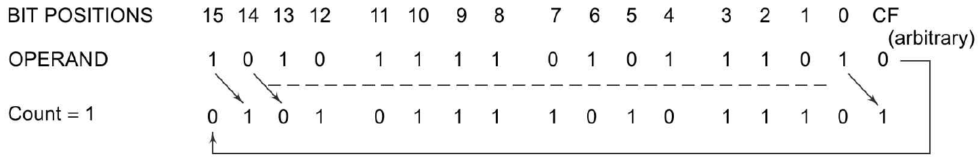
RCR
RCR Instruction : RCR destination, count
Rotates all bits in a specified byte or word some number of bit positions to the right along with the carry flag
LSB is placed as a new carry and previous carry is place as new MSB.
RCR CX, 1; MOV CL, 04H; RCR AL, CL

Slide 79
STRING MANIPULATION
INSTRUCTIONS

Slide 80
String Manipulation Instructions
REP
Used as a prefix to other instructions.
The instruction to which the prefix is provided, is executed repeatedly
until the CX becomes zero.
When CX=0, the execution proceeds to next instruction in sequence.

Slide 81
String Manipulation Instructions
MOVSB/MOVSW
Source string starting byte → SI + DS
Destination string starting byte → DI + ES.
Use REP as prefix to MOVS & length of the byte/ word string in CX.

Slide 82
String Manipulation Instructions
CMPSB/CMPSW
Used to compare two strings of bytes or words.
Length of the byte/ word string in CX.
If both bytes/ words are equal, ZF is set.
Strings are stored in DS:SI & ES:DI
REP is used to repeat the comparison operation till CX=0 or condition specified by REP fails.

Slide 83
CMPSB/CMPSW - Example

Slide 84
String Manipulation Instructions

Slide 85
Process Control & Branch Transfer
Instructions

Slide 86
Branch Instructions
Transfers the flow of execution of the program to a new address specified in the instruction directly or indirectly
CS and IP registers get loaded with new values of CS and IP corresponding to the location to be transferred
Unconditional Branch Instructions
Conditional Branch Instructions

Slide 87
Unconditional Branch Instructions
Execution control is transferred to the specified location independent of any status or condition
The CS and IP unconditionally modified to the new CS and IP
CALL : Unconditional Call
Call a Subroutine (Procedure) from a main program
Address of procedure may be specified directly or indirectly
NEAR CALL i.e., ±32K displacement
FAR CALL i.e., anywhere outside the segment
Stores the incremented IP & CS onto the stack and loads the CS & IP registers with segment and offset addresses of the procedure to be called

Slide 88
Unconditional Branch Instructions
RET: Return from the Procedure
At the end of the procedure, the RET instruction must be executed
Previously stored content of IP and CS along with Flags are retrieved into the CS, IP and Flag registers from the stack
Execution of the main program continues further
INT N: Interrupt Type N
In the interrupt structure of 8086, 256 interrupts are defined corresponding to the types from 00H to FFH
Type byte N is multiplied by 4 and the contents of IP and CS of the interrupt service routine will be taken from memory block in 0000 segment

Slide 89
INTO: Interrupt on Overflow
Executed, when the overflow flag OF is set.
This is equivalent to a Type 4 Interrupt instruction
JMP: Unconditional Jump
Unconditionally transfers the control of execution to the specified address using an 8-bit or 16-bit displacement
No Flags are affected by this instruction
IRET: Return from ISR
Values of IP, CS and Flags are retrieved from the stack to continue the execution of the main program.

Slide 90
LOOP : LOOP Unconditionally
This instruction executes the part of the program from the Label or address specified in the instruction upto the LOOP instruction CX number of times
At each iteration, CX is decremented automatically and JUMP IF NOT ZERO structure.
MOV CX, 0004H
MOV BX, 7526H
Label 1 MOV AX, CODE1
OR BX, AX
AND BX, AX
LOOP Label 1

Slide 91
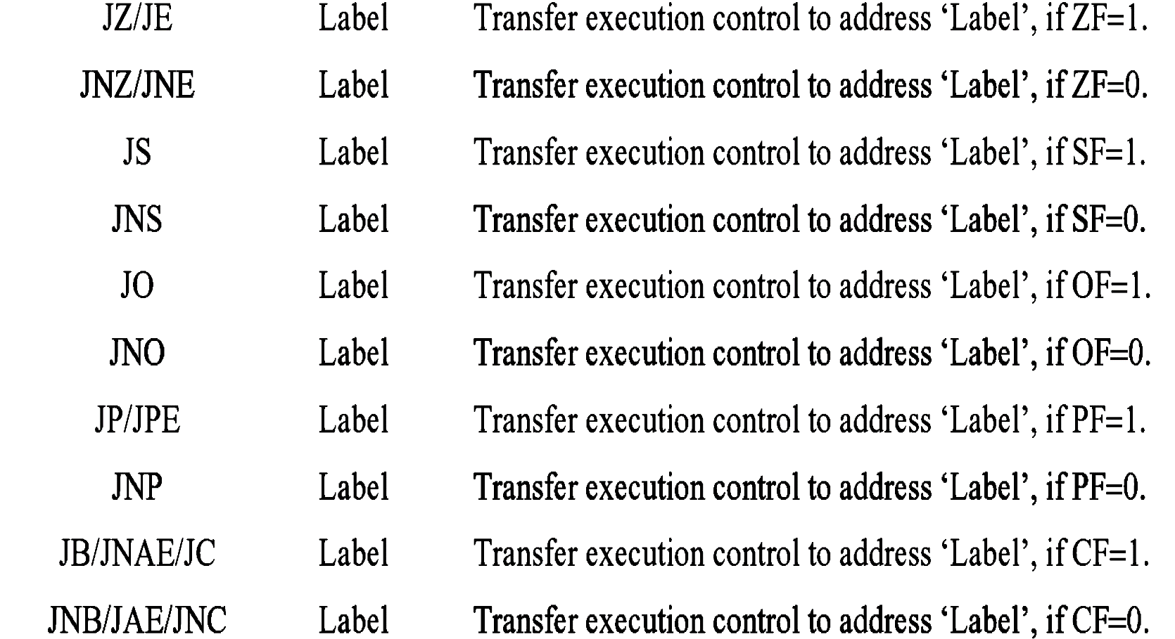
Conditional Branch Instructions
Execution control is transferred to the address specified relatively in the instruction, provided the condition implicit in the Opcode is satisfied
Otherwise execution continues sequentially.

Slide 92
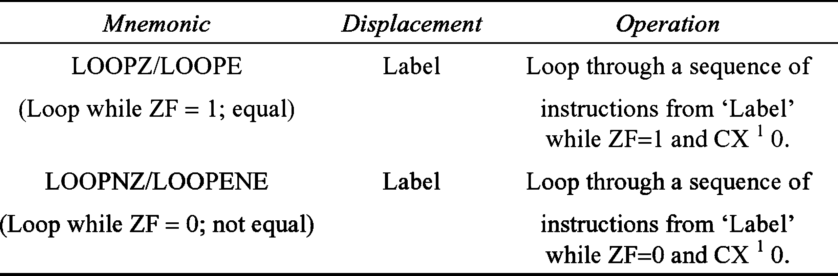
Conditional Loop Instruction

Slide 93
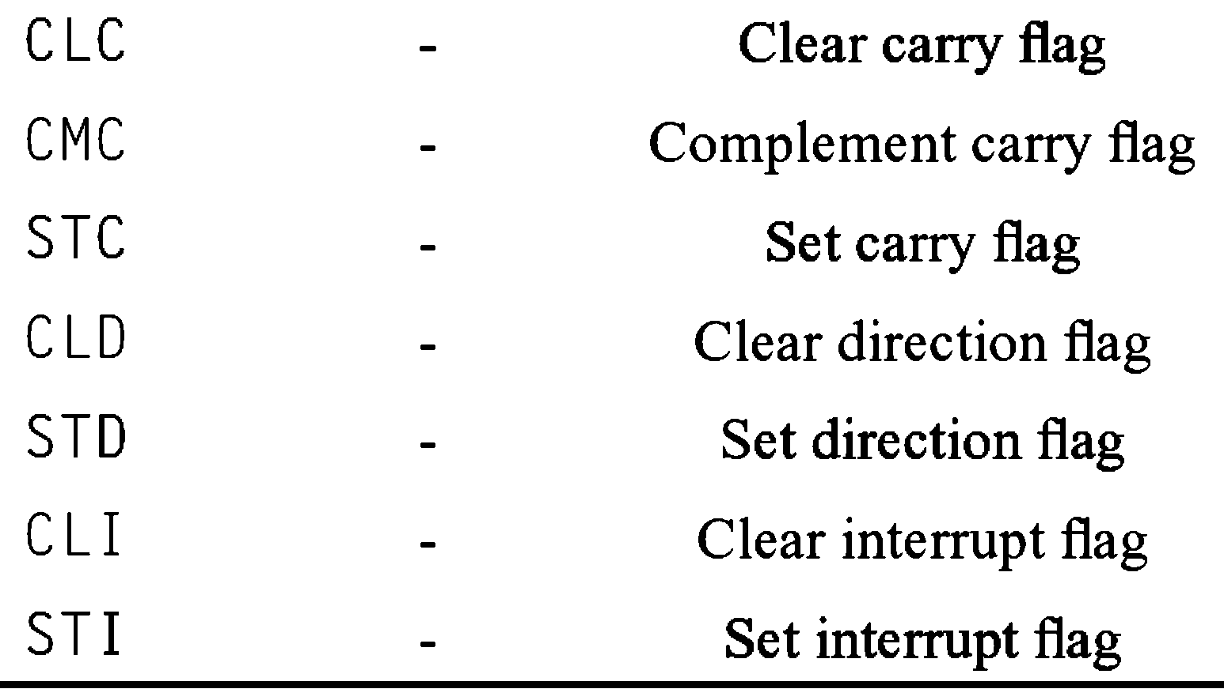
Flag Manipulation Instructions

Slide 94
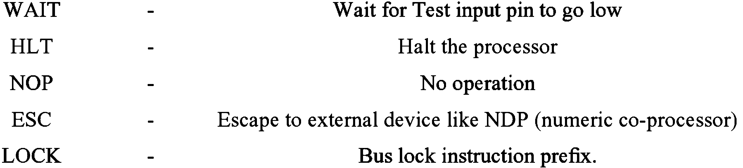
Machine Control Instructions

Slide 95
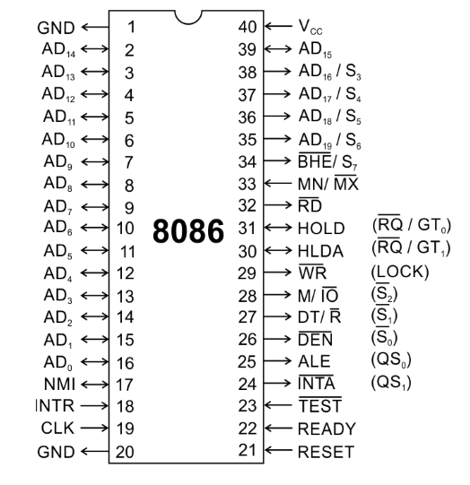
MIN & MAX MODEL

Slide 96
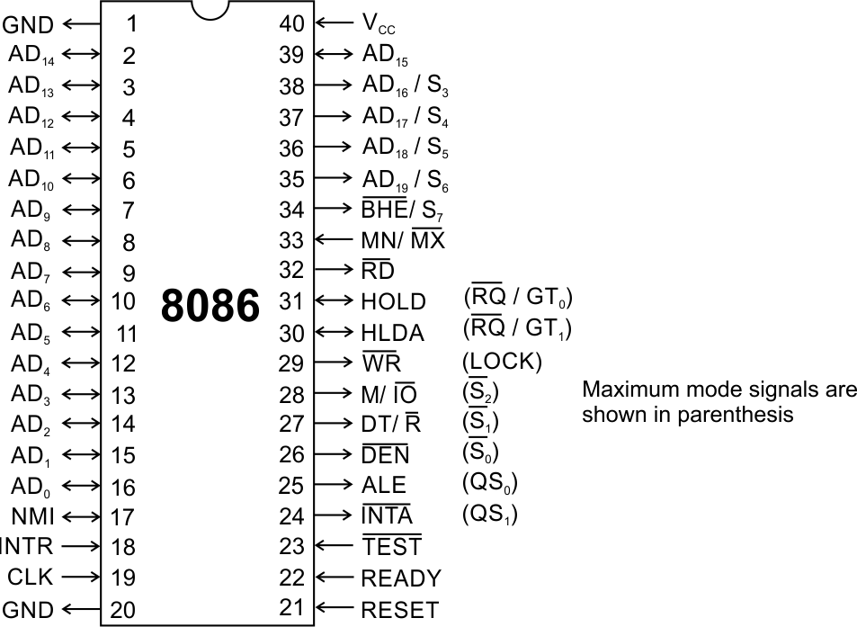

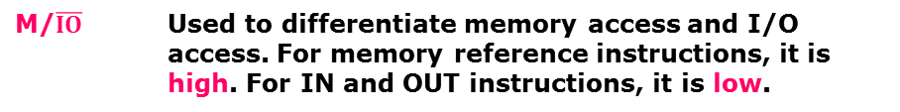


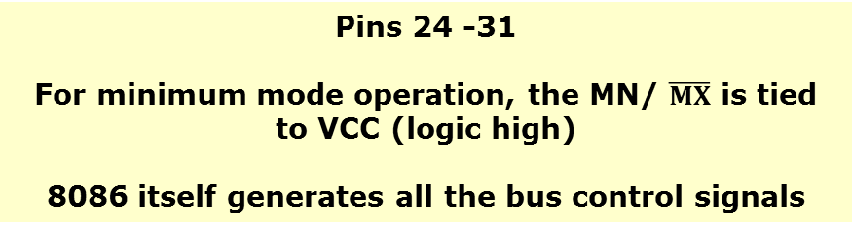

Minimum mode signals
8086 Microprocessor
Pins 24 -31
For minimum mode operation, the MN/ $\overline{MX}$ is tied to VCC (logic high)
8086 itself generates all the bus control signals
DT/$\overline{R}$ | (Data Transmit/ Receive) Output signal from the processor to control the direction of data flow through the data transceivers
$$\overline{DEN}$$ | (Data Enable) indicates the availability of valid data over the address/ data lines. It is used to enable the transceivers to separate the data from the muxed address/data signal. It is active from the middle of T2 until the middle of T4.
ALE | (Address Latch Enable) Indicates the availability of valid address on the address/data lines
M/$\overline{IO}$ | Used to differentiate memory access and I/O access. For memory reference instructions, it is high. For IN and OUT instructions, it is low.
$$\overline{WR}$$ | Write control signal; asserted low Whenever processor writes data to memory or I/O port
$$\overline{INTA}$$ | (Interrupt Acknowledge) When the interrupt request is accepted by the processor, the output is low on this line.

Slide 97
Minimum mode signals
8086 Microprocessor
HOLD | Indicates to the processor that another master is requesting the bus access. Processor issues HLDA in the middle of next clock cycle, after completing the current bus instruction cycle. Usually used by the DMA controller to get the control of the bus.
HLDA | (Hold Acknowledge) Acknowledge signal by the processor to the bus master requesting the control of the bus through HOLD. The acknowledge is asserted high, when the processor accepts HOLD. RD signal remains tristated

Slide 98
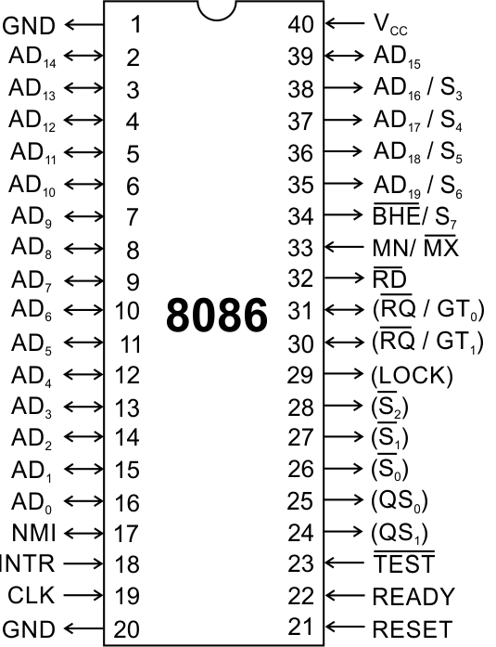
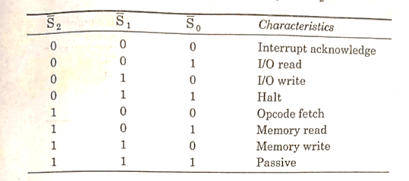
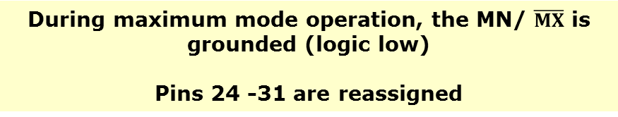
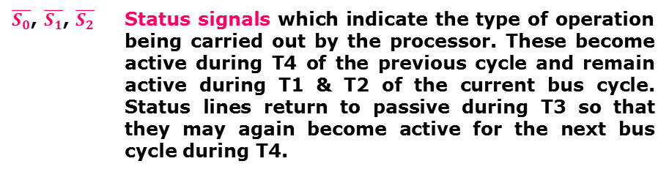
Maximum mode signals
8086 Microprocessor
During maximum mode operation, the MN/ $\overline{MX}$ is grounded (logic low)
Pins 24 -31 are reassigned
$\overline{S_{0}}$, $\overline{S_{1}}$, $\overline{S_{2}}$ | Status signals which indicate the type of operation being carried out by the processor. These become active during T4 of the previous cycle and remain active during T1 & T2 of the current bus cycle. Status lines return to passive during T3 so that they may again become active for the next bus cycle during T4.

Slide 99
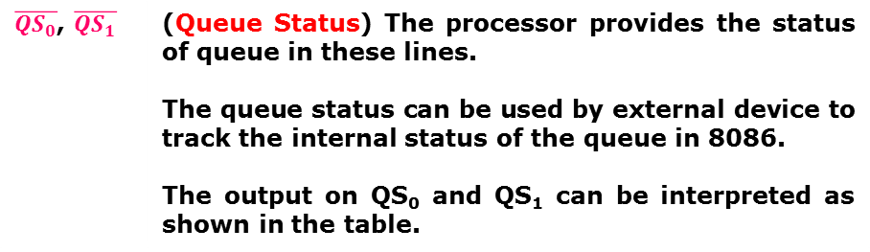
Maximum mode signals
8086 Microprocessor
During maximum mode operation, the MN/ $\overline{MX}$ is grounded (logic low)
Pins 24 -31 are reassigned
$\overline{{QS}_{0}}$, $\overline{QS_{1}}$ | (Queue Status) The processor provides the status of queue in these lines. The queue status can be used by external device to track the internal status of the queue in 8086. The output on QS₀ and QS₁ can be interpreted as shown in the table.

Slide 100
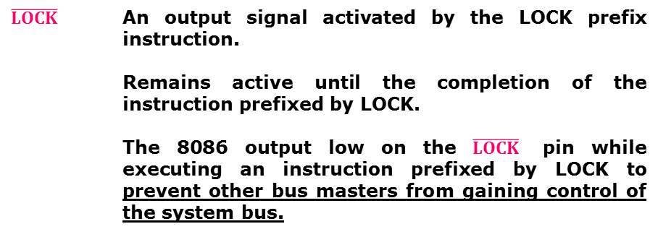
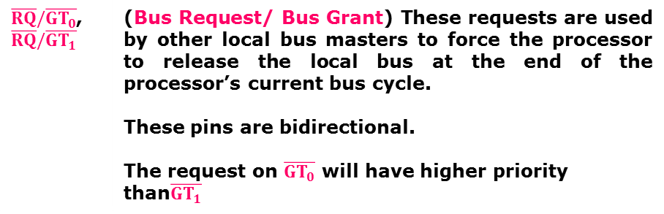
Maximum mode signals
8086 Microprocessor
During maximum mode operation, the MN/ $\overline{MX}$ is grounded (logic low)
Pins 24 -31 are reassigned
$\overline{RQ}/\overline{GT_{0}}$, $\overline{RQ}/\overline{GT_{1}}$ | (Bus Request/ Bus Grant) These requests are used by other local bus masters to force the processor to release the local bus at the end of the processor’s current bus cycle. These pins are bidirectional. The request on $\overline{GT_{0}}$ will have higher priority than$\overline{GT_{1}}$
$$\overline{LOCK}$$ | An output signal activated by the LOCK prefix instruction. Remains active until the completion of the instruction prefixed by LOCK. The 8086 output low on the $\overline{LOCK}$ pin while executing an instruction prefixed by LOCK to prevent other bus masters from gaining control of the system bus.

Slide 101
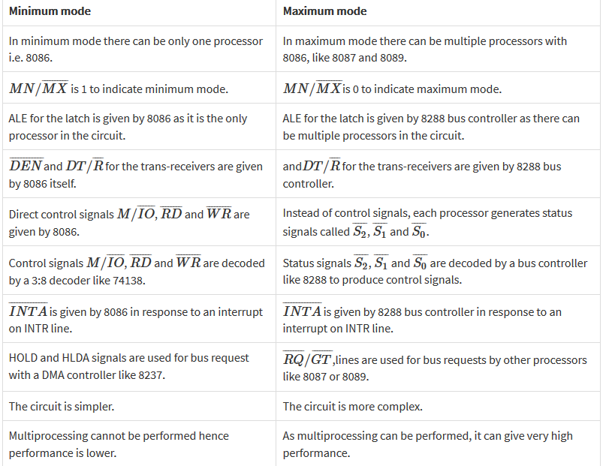

Slide 102
Peripheral Interfacing
Microprocessor based system design involves interfacing of the processor with one or more peripheral devices for the purpose of communication with various input and output devices connected to it.
During the early days of the microprocessor revolution, these techniques required complex hardware makeing the design highly complex and time consuming.
INTEL have developed a large number of general and special purpose peripheral devices, most of them being single chip circuits. They are also programmable devices.
Hence these peripheral devices are found to be of tremendous use to a system designer.

Slide 103
Types of Devices
General purpose peripherals and
Special purpose peripherals

Slide 104
General Purpose Peripheral Devices
Perform a task but may be used for interfacing a variety of I/O devices to microprocessor.
The general purpose devices are given below:
Simple I/O -- (Non-programmable)
Programmable peripheral Interface (PPI) – (8255)
Programmable Interrupt Controller – (8259)
Programmable DMA Controller – (8237/8257)
Programmable Communication Interface – (8251)
Programmable Interval Timer – (8253/8254)

Slide 105
Special Purpose Peripheral Devices
These peripherals are more complex and more expensive than general purpose peripherals.
The special function peripherals are
Programmable CRT Controller
Programmable Floppy Disc Controller
Programmable Hard Disc Controller
Programmable Keyboard and display interface.
The functioning of these devices varies depending on the type of I/O device they are controlling.

Slide 106
Programmable peripheral interface-8255
8255 is a widely used, programmable, parallel I/O device.
The PPI has three programmable I/O ports viz., Port A, Port B and Port C each of 8 bit width.
Port C can be treated as two ports – Port C upper (PC7-4) and Port lower (PC3– 0) and these two can be independently programmed as INPUT or OUTPUT ports.

Slide 107
Programmable peripheral interface-8255
It is a general purpose programmable I/O device which is compatible with all INTEL processors and also most other processors.
It provides 24 I/O pins which may be individually programmed in two groups. The two groups of I/O pins are named as Group A and Group B.
It is available in 40 pin DIP.
8255 is mainly programmed in two modes (a) I/O mode and (b) bit set/reset mode (BSR) mode. The I/O mode is further divided into three modes: Mode 0, Mode 1, and Mode 2.

Slide 108
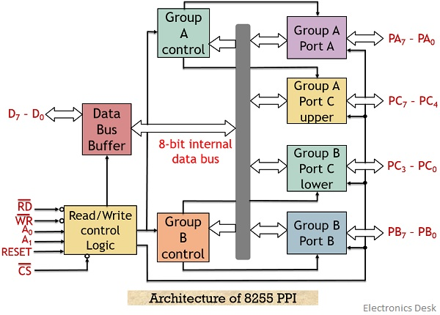
Block Diagram - 8255

Slide 109

8255 - Architecture
The 8-bit data bus buffer is controlled by R/W Control logic.
The R/W control logic manages all of the internal/ external transfers of both data and control words.
Inputs to R/W : $\overline{RD},\overline{WR,}$ A1, A0 and RESET
The 8-bit, tri-state, bidirectional buffer is used to interface the internal data bus with the external system data bus.
This buffer receives or transmits data upon execution of input or output instructions by 8086.
The control word or status information is also transferred through this buffer.

Slide 110
8255 - Architecture
Group A Control and Group B Control
Group A control block controls - PortA and PC7-PC4.
Group B controls block controls - Port B and PC3- PC0
Data Bus buffer :
8 bit, 3-state bidirectional used to interface the internal data bus of 8255 to the external system data bus.
Output data from the MPU to the ports or control register and the input data to the MPU from the ports or status register are all pushed through the buffer.
It is controlled by the read/write control logic.
Control Logic
Manage all internal and external transfer of data and control words.
RD’, WR’, A1, A0 and RESET are inputs provided by MPU
It issues commands to the individual group control blocks (Group A Control and Group B Control)

Slide 111
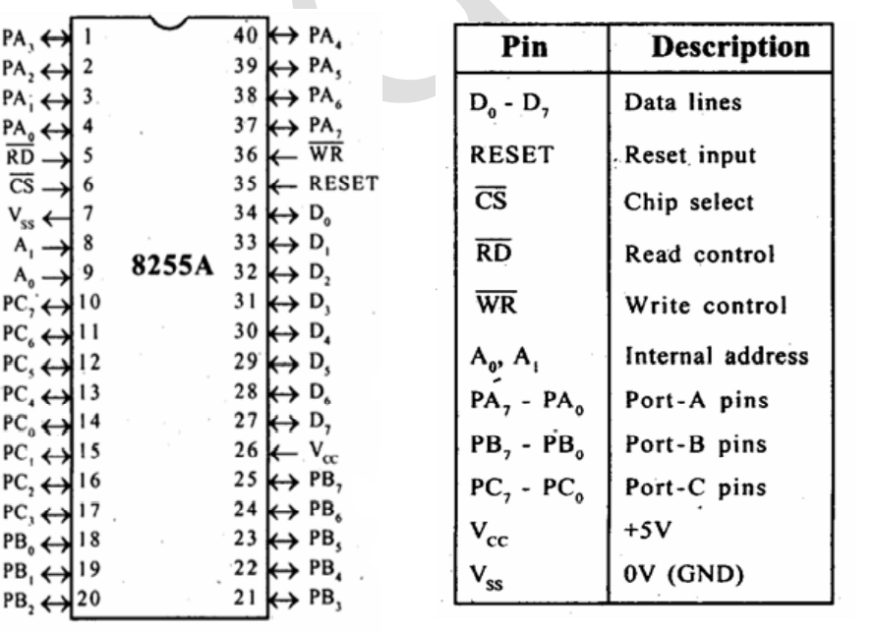
Pin diagram -8255

Slide 112
Modes of Operation
Bit Set-Reset Mode (BSR) – used to set or reset its individual port bits.
I/O mode – 8255 ports works as programmable I/O ports
Mode 0: Simple I/O mode
Mode 1 : I/O with Handshaking mode
Mode 2: Bidirectional data transfer mode

Slide 113
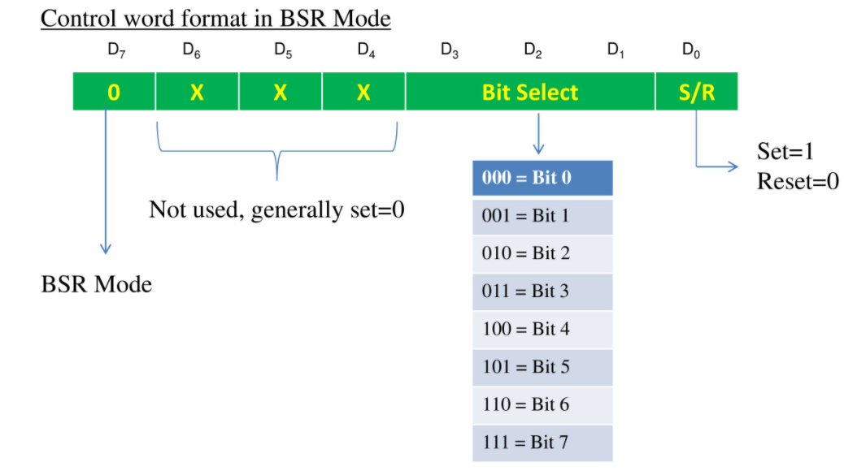
BSR Mode
To know in which mode the interface is working we need to know the value of Control word.
Control word is a part of control register in 8255 which specify an I/O function for each port.
This mode is used to set or reset the bits of the Port-C only.
For BSR mode always D7 will be 0.
The (D3, D2, D1) will be 000 to 111.
In this mode it affects only one bit of Port C at a time.
When user set the bit, it remains set until user unset it.
The user needs to load the bit pattern in control register to change the bit.

Slide 114
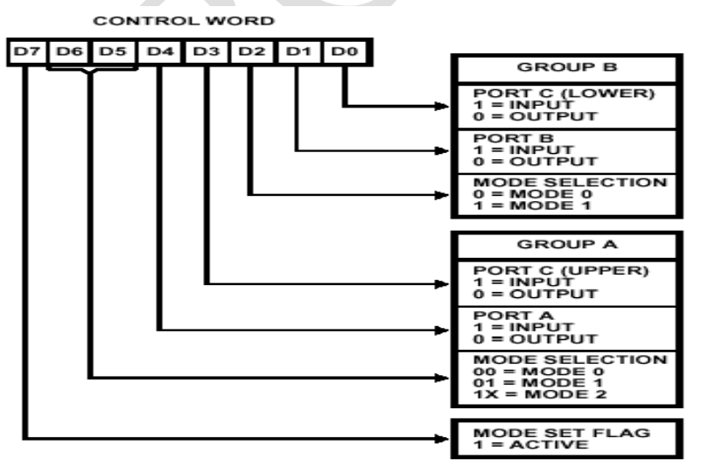
I/O Mode
Mode 0 : Basic Input/output
provides simple input and output operations for each of the three ports.
There are two 8-bitports (A and B) and two 4-bit ports [C (lower)] and [C (upper)].
Any port can be an input port or an output port.
Features:
Outputs are latched and Inputs are not latched.
Ports do not have handshake or interrupt capability

Slide 115
Mode 1- Strobed I/O
It provides means for transferring I/O data to or from a specified port in conjunction with strobes or hand-shaking signals.
Port A and port B use the lines on port C for handshaking signals.
Features,
Two ports A and B function as 8 bit I/O ports.
Each port uses three lines from port C as handshake signals and remaining signals used for I/O functions
Input and output data are latched
Interrupt logic is supported

Slide 116
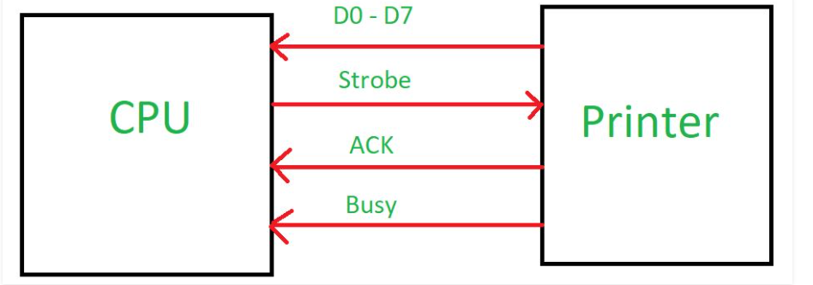
Mode 1- 1
When CPU wants to send data to slow peripheral device like printer, it will send handshaking signal to printer to tell whether it is ready or not to transfer the data.
When printer will be ready, it will send one acknowledgement to CPU then there will be transfer of data through data bus.

Slide 117
Mode 2
In this mode only port A works, and port B can work either in mode 0 or mode 1.
Port A is used as bi-directional port with simultaneous input and output capability.
5 bits port C are used as handshake signals.
It also has interrupt handling capacity.

Slide 118
Steps to Communicate with 8255
Determine the addresses of Port A, B, C and Control register according to Chip Select Logic and the Address lines A0 and A1.
Write a control word in control register.
Write I/O instructions to communicate with peripherals through port A, B, C.

Slide 119
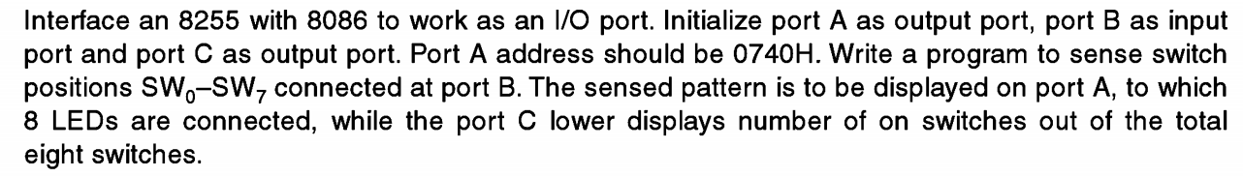
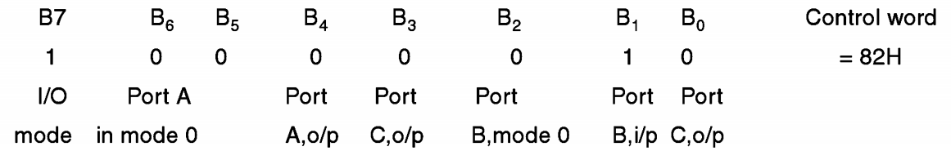
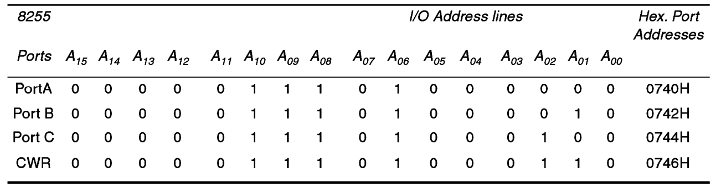
Steps to Communicate with 8255
CWR
Port Address

Slide 120
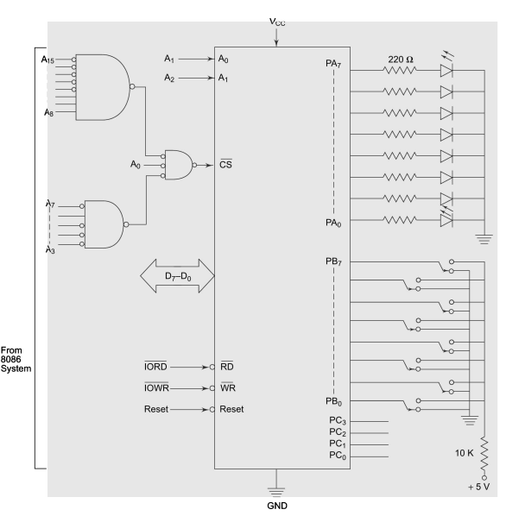
Steps to Communicate with 8255

Slide 121
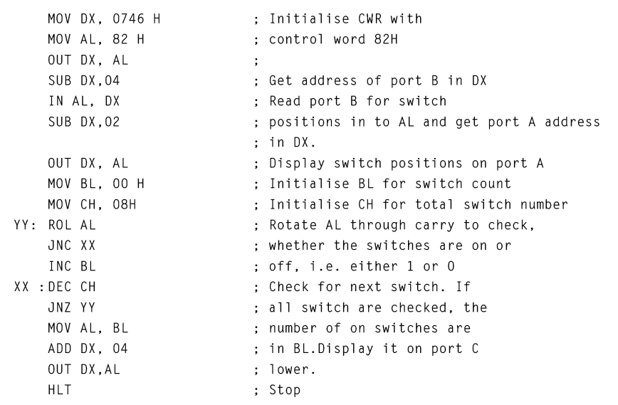
ALP

Slide 122
What is a Timer?
Timer is a specialized type of device that is used to measure timing intervals.
Timers can be categorized into two main types:
A timer which counts upwards from zero for measuring elapsed time is often called a stopwatch
a device which counts down from a specified time interval is more usually called a timer.
Timers may be designed in software or in hardware.
When the microprocessor needs to generate a time delay, the processor can elapse time simply using a delay routine.

Slide 123
Why dedicated timer IC is required?
When a specialized IC is used for the generation of delays and waveforms of different frequencies, microprocessor becomes free from these tasks and this minimizes the software overhead of the processor.
Computer systems usually have at least one hardware timer.
These are typically digital counters that either increment or decrement at a fixed frequency, which is often configurable, and which interrupt the processor on reaching zero.
8253 is one such hardware timer.

Slide 124
What is 8253 Timer?
What is 8253 Timer?
Intel 8253 programmable Timer/ counter is a specially designed chip for Intel microcomputer applications which require timing and counting operations.
Designed for being compatible with INTEL microprocessors like 8085,8086, 80X86..
8254 is an advanced version of 8253.
8253/8254 are programmable using three 16-bit counters.
Each counter has 2 input pins, Clock & Gate, and 1 pin for “OUT” output.
To operate a counter, a 16-bit count is loaded in its register.
On command, it begins to decrement the count until it reaches 0, then it generates a pulse that can be used to interrupt the CPU.

Slide 125
Features of 8253/54
It has three independent 16-bit down counters.
It can handle inputs clocks upto 10 MHz.
These three counters can be programmed for either hexadecimal or BCD count.
It is compatible with almost all microprocessors.
8254 has a powerful command called READ BACK command, which allows the user to check the count value, the programmed mode, the current mode, and the current status of the counter.

Slide 126
8253
8253
The timers are basically 16 - bit down counters that counts at HIGH to LOW transition of the CLK input.
Each timer may be programmed to operate in one of the six modes, independent of the mode of operation of the other two timers.
The timers are software programmable.
Each counter can be programmed separately to divide the input frequency by a number from 1 to 65536 (2¹⁶)

Slide 127
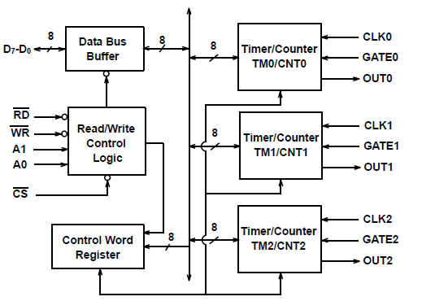
Functional Block diagram of 8253
Functional Block Diagram of 8253

Slide 128
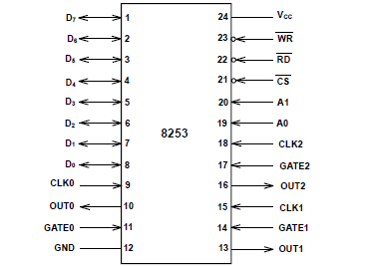
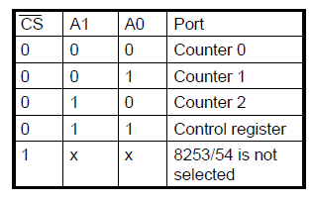
Pin Diagram and Address Decoding
Pin diagram & Address Decoding

Slide 129

Data Bus Buffer
Data Bus buffer is a tri-state bidirectional buffer that communicates with CPU whenever $\overline{CS}$ (Chip Select) is low.
Data is transmitted or received by executing the OUT PORT and IN PORT instructions.
The functions of Data bus buffer are
1. Programming the counters through the control words
2. Writing count to the counters
3. Reading the count value from timers.

Slide 130

Control Register
Control Register
The control word register is used to program the timers in different modes and control their operations.
It is selected when A0 and A1 pins are 1,1. If $\overline{CS} and \overline{WR}$ are low, it accepts information from the data bus buffer and stores it in control word register.
The word stored in CR controls the operation mode of each counter, selection of hexadecimal or BCD counting and loading of each count register.
This register can be written into only no read operation of this content is available

Slide 131
Counters
Counters
Each of the timers has three pins associated with it. Clock (CLK) input, gate (GATE) control input and output (OUT).
CLK - This clock input causes the timer to decrement. Counters operate at HIGH to LOW transition (the negative edge) of this clock input.
GATE - The gate input pin is used to initiate or enable counting. The exact effect of the gate signal depends on which of the six modes of operation is chosen.
OUTPUT- The output pin provides an output from the timer. Its actual use depends on the mode of operation of the timer. The counter can be read “on the fly” without inhibiting gate pulse or clock input.

Slide 132

Operations for Various Control Inputs
Operations of Various Control Input

Slide 133
Control Word Format
Control Word Formate

Slide 134
Modes of 8253
Modes of 8253
Mode 0 – Interrupt on Terminal Count
Mode 1 – Programmable Mono shot
Mode 2 – Rate Generator
Mode 3 – Square wave Generator
Mode 4 – S/w triggered Strobe
Mode 5 – H/w triggered Strobe

Slide 135
Modes 0 – Interrupt on terminal count
Output is initially low after the mode is set.
Output remains low even after the count value is loaded in the counter.
Counter starts decrementing after the falling edge of the clock, if the GATE input is high.
Output will remain low until the Counter reaches zero.
OUT then goes high and remains high until a new count or a new Mode 0 Control Word is written into the Counter.

Slide 136
Mode 1-Programmable Mono-shot
OUT is high until the count is loaded and the trigger is applied.
OUT will go low on the CLK pulse following a trigger and will remain low until the Counter reaches zero.
OUT will then go high and remain high until the next count is loaded or a trigger is applied.

Slide 137
Mode 2 – Rate Generator
This Mode functions like a divide-by-N counter.
OUT will initially be high. When the initial count has decremented to 1, OUT goes low for one CLK pulse.
OUT then goes high again, the Counter reloads the initial count and the process is repeated.
Mode 2 is periodic; the same sequence is repeated indefinitely. For an initial count of N, the sequence repeats every N CLK cycles.

Slide 138
Mode 3 – Square Wave Generator
Mode 3 is similar to Mode 2 except for the duty cycle of OUT signal.
OUT will initially be high. When half the initial count has expired, OUT goes low for the remainder of the count.
Mode 3 is periodic; the sequence above is repeated indefinitely. An initial count of N results in a square wave with a period of N CLK cycles.
If the loaded count value N is odd, for (N+1)/2 pulses, OUT remains high and for (N-1)/2 pulses, it is low.

Slide 139
Mode 4 – Software Triggered
OUT will be initially high. When the initial count expires, OUT will go low for one CLK pulse and then go high again.
Similar to Mode 2, except that the counter is not reloaded automatically, count has to be reloaded.

Slide 140

Mode 5 – Hardware Triggered
OUT will initially be high.
Counting is triggered by a rising edge of GATE.
When the initial count has expired, OUT will go low for one CLK pulse and then go high again.
After writing the Control Word and initial count, the counter will not be loaded until the CLK pulse after a trigger.

Slide 141

Example 1

Slide 142
Example 2
What instructions are needed to program Counter 0 for BCD counting in mode 4? Initial count is 4788H.
Solution :
Control Word = 00 11 100 1 = 39H
Counter 0 LSB & MSB Mode 4 BCD
MOV AL,39H
OUT CWR,AL
MOV AL,88
OUT Counter0,AL ; Counter0 =8-bit address of counter0
MOV AL,47
OUT Counter0,AL

Slide 143
Example 3
What instructions are needed to program Counter 2 for binary counting in mode1, with an initial count of A0H?
Solution
Control Word = 10 01 001 0 (92H)
Program
MOV AL, 92H
OUT CWR,AL ; CWR= Address of Control Register
MOV AL,0A0H
OUT Counter2,AL ; Counter2 = 8-bit address of counter2

Slide 145

Port Address mapping

Slide 146
Square Wave – Mode 3
Count = Clock frequency / Square wave frequency
Clock frequency = 1.5 MHz
Square wave frequency = 1/time period = 1/1ms = 1 kHz
Count = 1.5 M/ 1 k = 1500
Control word for Counter 0:
0 | 0 | 1 | 1 | 0 | 1 | 1 | 1

Slide 147
ii. Generate Interrupt – Mode 0
Count = Clock frequency / Counter frequency
Clock frequency = 1.5 MHz
Counter frequency = 1/time period = 1/10ms = 0.1 kHz
Count = 1.5 M/ 0.1 k = 15000 = 3A98H
Control word for Counter 1:
0 | 1 | 1 | 1 | 0 | 0 | 0 | 0

Slide 148
iii. Generate Mono shot – Mode 1
Count = Clock frequency / Counter frequency
Clock frequency = 1.5 MHz
Counter frequency = 1/time period = 1/5ms = 0.2 kHz
Count = 1.5 M/ 0.2 k = 7500 =1D4CH
Control word for Counter 2:
1 | 0 | 1 | 1 | 0 | 0 | 1 | 0

